Slide 1
Project Three
How to become a Hollywood millionaire
Matthew Berry
Anna Kantor
Andre Shearer
Renuka Kafle

Slide 2
Project Three
What elements of production and release can help predict the financial success of a movie?
How can those elements be used to predict such success, specifically in the context of machine learning?

Slide 3
Data
Two years ago, a competition was held on Kaggle.
The challenge was to use an existing data set to predict a movie’s worldwide box office revenue.
Despite the fact we were two years late to the party, we decided to use the provided data set to attempt our own prediction using the machine learning library known as Scikit-Learn.

Slide 4
Attempted models
Multiple Input Linear Regression
Random Forest Classifier
Random Forest Regression
Neural Network

Slide 5
Which type of model to use?
Considerations
Factors
We’re noobs.
Our dataset was “relatively” small.
The time frame was...compressed.
We wanted to know which inputs were most important to the prediction.
Random forest algorithms are relatively simple.
This makes it ideal for a group of noobs with a deadline.
Random forest regression algorithms are ideal for high-dimensional datasets (another relative term, but we wanted to use several different attributes).
Random forest algorithms make it easy to measure the relative importance of each feature on the prediction and Sklearn provides an easy tool for such an analysis.

Slide 6
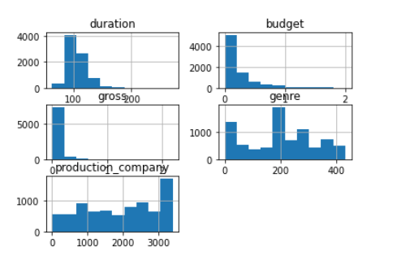
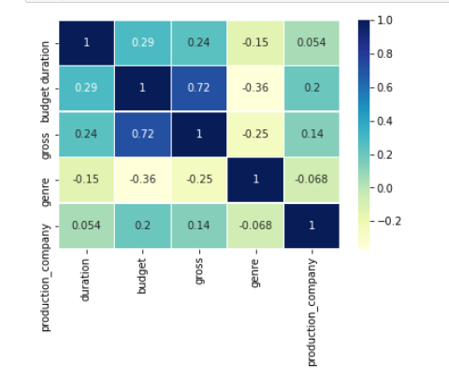
Data Analysis From this correlation heat map, we can see that gross revenue is strongly correlated to budget but much less correlated to the movie’s production company.

Slide 7
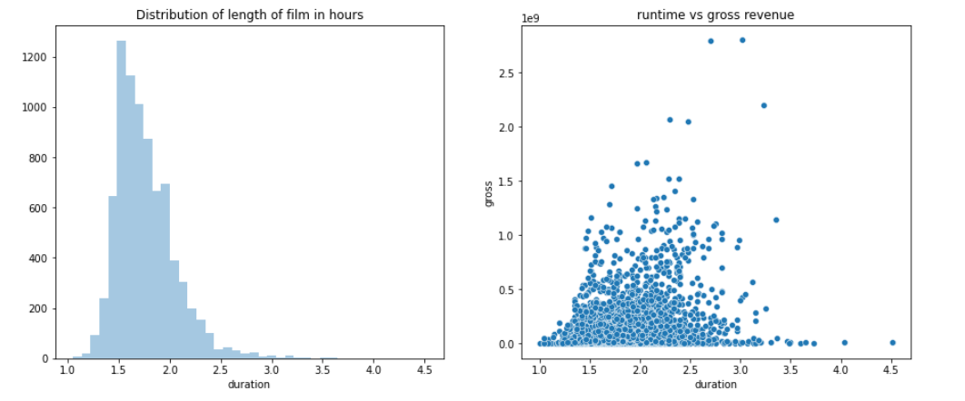
Gross Revenue Vs. Duration Here we have duration measured in hours on the x-axis and the number of movies in the dataset on the y axis. Here we can see that most of the movies are between 1.5 to 3 hours and movies of that duration have the highest revenues.

Slide 8
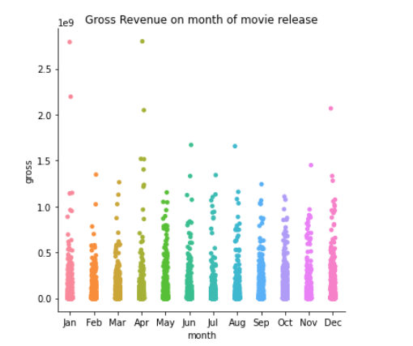
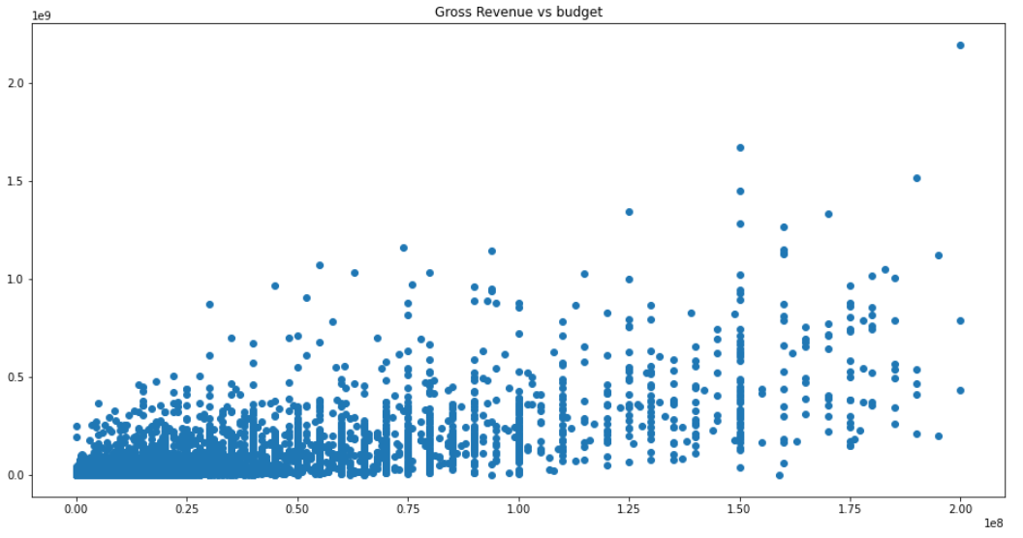
Release month and Budget vs. Revenue From this figure, we can see that movies released in January and April have the highest gross revenues. Also, we can see that there is a strong correlation between budget and revenue.

Slide 9

Process
Use CountVectorizer method to create a matrix of token counts for “genre” and “language.”
1
Split data into “train” and “test”
2
Train model with the “train” data
3
Test model with “test” data
4
Score model
5

Slide 10

R² Score
Translation: Almost 90% of the variance in our prediction of gross revenue is explained by our inputs.

Slide 11

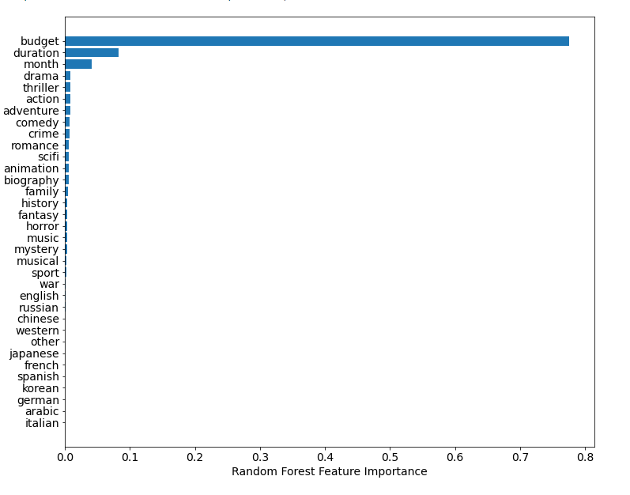



Feature Importance

Slide 12
File Structure
app.py
data
assets
model
model training notebook
final model
static
templates
CSS
images
index.html

Slide 13

Project Issues
Timeline
Neural Network
Style
Size of model
Finding a different host
Amount of Data
Webscrape?

Slide 14

Go Deeper
As budget is the most important feature, a deeper dive could include which pieces of budgets are most important.
As Marvel, Star Wars, Disney, and Pixar, dominate the box office a deeper dive of those specific movies may give us a better idea of why they’re so successful.
Find out how we compared to other teams in the Kaggle competition.
This Photo by Unknown Author is licensed under CC BY-NC-ND

